Slide 1




DIGITAL PORTFOLIO
STUDENT NAME : S.Sruthi
REGISTER NO AND NMID : 2426j0713,C6795B5614ED8FD44FCA2A9CC4296
DEPARTMENT: Information technology
COLLEGE : COLLEGE/ UNIVERSITY:
Pioneer College of arts and sciences Jothipuram,BHARATHIAR UNIVERSITY

Slide 2
PROJECT TITLE WEB DEVELOPMENT FUNDAMENTALS

Slide 3



AGENDA
Problem Statement
Project Overview
End Users
Tools and Technologies
Portfolio design and Layout
Features and Functionality
Results and Screenshots
Conclusion
Github Link
3/21/2024 Annual Review

Slide 4


PROBLEM STATEMENT
Many people struggle to create professional portfolios. Lack of coding knowledge becomes a barrier. Traditional methods are time-consuming and less attractive. Need for a simple, responsive, and customizable portfolio.

Slide 5

PROJECT OVERVIEW
Objective: Build a responsive portfolio website using HTML, CSS, and JavaScript. PURPOSE: To showcase skills, projects, and achievements. OUTCOME:A modern, user-friendly personal portfolio.

Slide 6


WHO ARE THE END USERS?
*Students creating personal portfolios. *Job seekers applying for opportunities. *Freelancers showcasing their work. *Professionals wanting a digital identity.

Slide 7
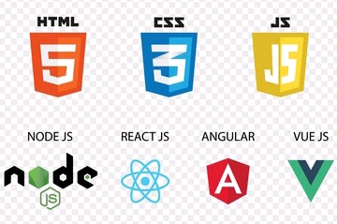
TOOLS AND TECHNIQUES
Front-End Development Tools *HTML5: Provides the structure of the website, supports multimedia, semantic tags. *CSS3: Used for styling, layouts, animations, and responsiveness.

Slide 8
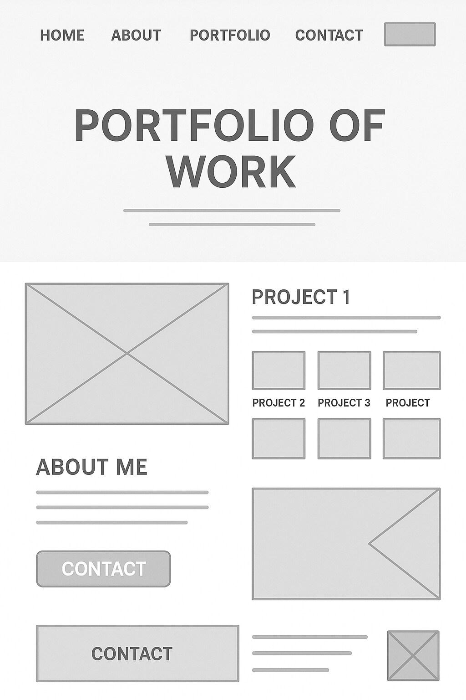
POTFOLIO DESIGN AND LAYOUT
*Homepage: Clean intro with name, title, and short tagline. *About Me: Educational background, skills, and interests. *Projects: Showcase with descriptions, images, and links. *Skills Section: Represented visually with progress bars or logos. *Contact Section: Email form, social media links, or direct call option.
8

Slide 9

FEATURES AND FUNCTIONALITY
Responsive Design: Works on mobile, tablet, and desktop. Interactive Navigation: Smooth scrolling, hover effects, clickable icons. Dynamic Content: Option to add new projects easily. Security: Spam protection on contact forms. Performance: Fast-loading, optimized images, SEO-friendly.

Slide 10
GITHUB LINK
https://github.com/sruthisenthi653-prog/portfolio.git
3/21/2024 Annual Review
10

Slide 11
CONCLUSION
A portfolio website is essential in modern career development. The project provides a simple, scalable, and professional solution. Helps in personal branding, placements, and freelancing opportunities. Easy to modify and deploy using GitHub and other free tools.
11

Slide 12




